Slide 1
Analysis of Count Data Chapter 26
Goodness of fit
Formulas and models for two-way tables
- tests for independence
- tests of homogeneity

Slide 2

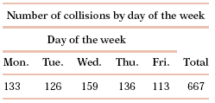

Example 1:
Car accidents and day of the week
A study of 667 drivers who were using a cell phone when they were involved in a collision on a weekday examined the relationship between these accidents and the day of the week.
Are the accidents equally likely to occur on any day of the working week?

Slide 3

Example 2: M & M Colors
Mars, Inc. periodically changes the M&M (milk chocolate) color proportions. Last year the proportions were:
yellow 20%; red 20%, orange, blue, green 10% each; brown 30%
In a recent bag of 106 M&M’s I had the following numbers of each color:
Is this evidence that Mars, Inc. has changed the color distribution of M&M’s?
Yellow | Red | Orange | Blue | Green | Brown
29 (27.4%) | 23 (21.7%) | 12 (11.3%) | 14 (13.2%) | 8 (7.5%) | 20 (18.9%)

Slide 4
Example 3: Are successful people more likely to be born under some astrological signs than others?
256 executives of Fortune 400 companies have birthday signs shown at the right.
There is some variation in the number of births per sign, and there are more Pisces.
Can we claim that successful people are more likely to be born under some signs than others?
Births | Sign
23 | Aries
20 | Taurus
18 | Gemini
23 | Cancer
20 | Leo
19 | Virgo
18 | Libra
21 | Scorpio
19 | Sagittarius
22 | Capricorn
24 | Aquarius
29 | Pisces

Slide 5
To answer these questions we use the chi-square goodness of fit test
Data for n observations on a categorical variable
  (for example, day of week, color of M&M)
with k possible outcomes
  (k=5 weekdays, k=6 M&M colors)
are summarized as observed counts, n₁, n₂, . . . , n_{k} in k cells.
2 hypotheses: null hypothesis H₀ and alternative hypothesis H_{A}
H₀ specifies probabilities p₁, p₂, . . . , p_{k} for the possible outcomes.
H_{A} states that the probabilities are different from those in H₀

Slide 6
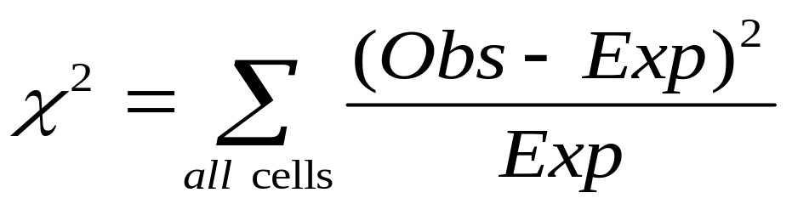
The Chi-Square Test Statistic
The Chi-square test statistic is:
where:
Obs = observed frequency in a particular cell
Exp= expected frequency in a particular cell if H₀ is true
The expected frequency in cell i is np_{i}

Slide 7
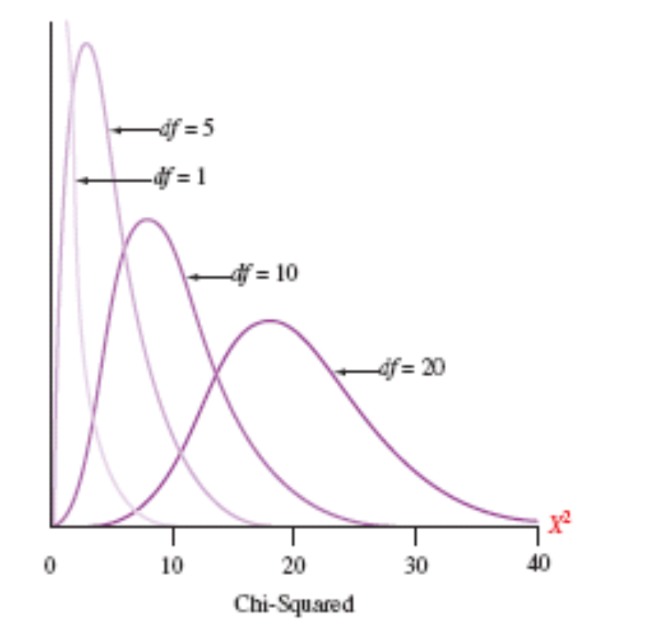
Chi-Square Distributions

Slide 8

The Chi-Square Test Statistic (cont.)
The χ² test statistic approximately follows a chi-squared distribution with k-1 degrees of freedom, where k is the number of categories.
If the χ² test statistic is large, this is evidence against the null hypothesis.
Decision Rule:
If ,reject H₀, otherwise, do not reject H₀.
.05
0
χ²
Do not
reject H₀
Reject H₀
χ²_{.05}

Slide 9
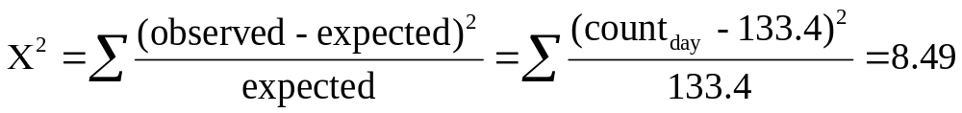
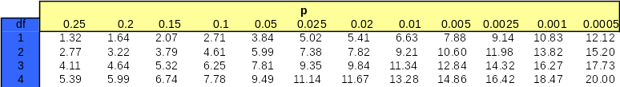
Car accidents and day of the week
(compare X² to table value)
H₀ specifies that all days are equally likely for car accidents ➔ each p_{i} = 1/5.
The expected count for each of the five days is np_{i} = 667(1/5) = 133.4.
Following the chi-square distribution with 5 − 1 = 4 degrees of freedom.
Since the value 8.49 of the test statistic is less than the table value of 9.49, we do not reject H₀
➔ There is no significant evidence of different car accident rates for different weekdays when the driver was using a cell phone.

Slide 10
Car accidents and day of the week
(bounds on P-value)
H₀ specifies that all days are equally likely for car accidents ➔ each p_{i} = 1/5.
The expected count for each of the five days is np_{i} = 667(1/5) = 133.4.
Following the chi-square distribution with 5 − 1 = 4 degrees of freedom.
7.78 < X²= 8.49 < 9.49
Thus the bounds on the P-value are 0.05 < P-value < 0.1
We don’t know the exact P-value but we DO know that P-value > 0.05, thus we conclude that …
➔ There is no significant evidence of different car accident rates for different weekdays when the driver was using a cell phone.

Slide 11

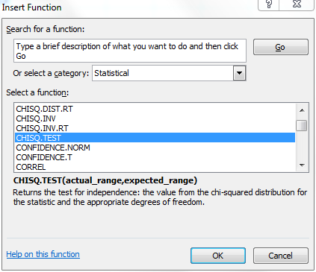
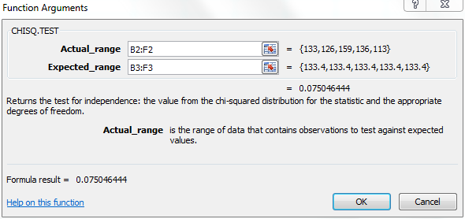
Using software
The chi-square function in Excel does not compute expected counts automatically but instead lets you provide them. This makes it easy to test for goodness of fit. You then get the test’s p-value—but no details of the X² calculations.
=CHITEST(array of actual values, array of expected values)
with values arranged in two similar r * c tables
--> returns the p value of the Chi Square test

Slide 12
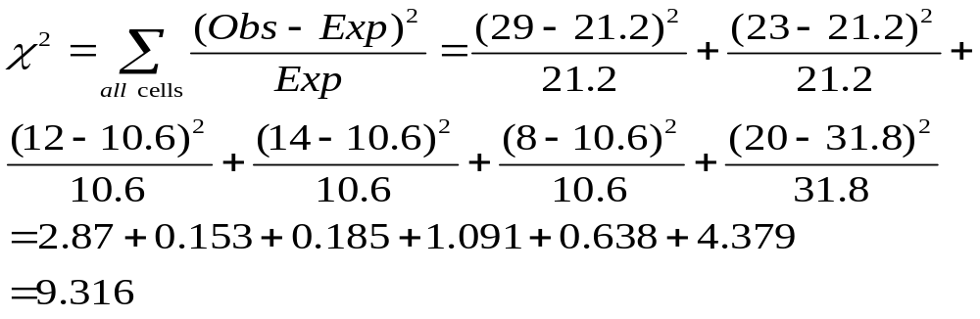
Example 2: M & M Colors
H₀ : p_{yellow}=.20, p_{red}=.20, p_{orange}=.10, p_{blue}=.10, p_{green}=.10, p_{brown}=.30
Expected yellow = 106*.20 = 21.2, etc. for other expected counts.
 | Yellow | Red | Orange | Blue | Green | Brown | Total
Obs. | 29 | 23 | 12 | 14 | 8 | 20 | 106
Exp. | 21.2 | 21.2 | 10.6 | 10.6 | 10.6 | 31.8 | 106

Slide 13


Example 2: M & M Colors (cont.)
Decision Rule:
If ,reject H₀, otherwise, do not reject H₀.
0.05
Here,
= 9.316 < = 11.070,
so we do not reject H₀ and conclude that there is not sufficient evidence to conclude that Mars has changed the color proportions.
0
χ²
Do not
reject H₀
Reject H₀
χ²_{0.05} = 11.070

Slide 14
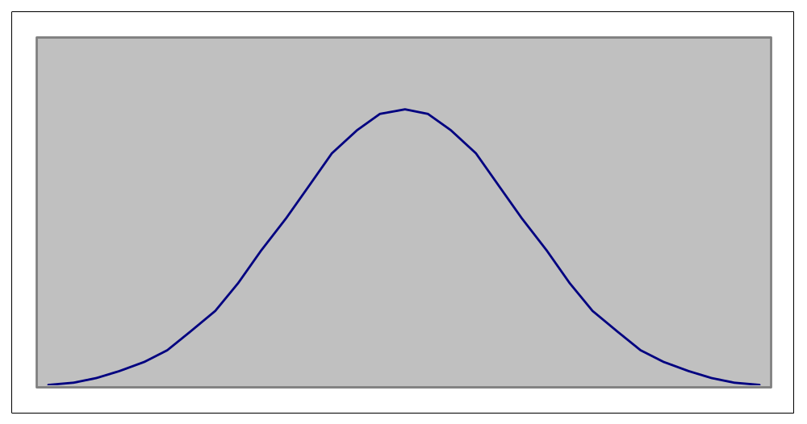
Chi-Squared test for Normality
The goodness of fit Chi-squared test can be used to determined if data were drawn from any distribution.
The multinomial experiment produces the test statistic.
Testing goodness of fit for
the normal distribution
Select values of z_{i} such that
the expected frequency in each
interval (z_{i}, z_{i+1}) is at least 5.
For example:
P(z₁<z<z₂)=p₂
np₃ > 5
np₃ > 5
np₂ > 5
np₂ > 5
Test the hypotheses:
H₀: P₁= p₁,…, P_{k} = p_{k}
H₁: At least one proportions differs
from its specified value.
p₃
p₃
np₁ > 5
p₂
p₂
np₁ > 5
p₁
p₁
z₁
z₂
z₃
z₄

Slide 15
Example: For a sample size of n=50 ,the sample mean was 460.38 with
standard error of 38.83. Can we infer from this data that this sample was selected from an approx. normal distribution with  = 460.38 and s = 38.83? Use 5% significance level.
Solution
First let us select z values that define each cell (expected frequency > 5 for each cell.)
z₁ = -1; P(z < -1) = p₁ = .1587; e₁ = np₁ = 50(.1587) = 7.94
z₂ = 0; P(-1 < z< 0) = p₂ = .3413; e₂ = np₂ = 50(.3413) = 17.07
z₃ = 1; P(0 < z < 1) = p₃ = .3413; e₃ = 17.07
P(z > 1) = p₄ = .1587; e₄ = 7.94
Expected frequencies
f₃ = 19
Sample frequencies
The cell boundaries are calculated
from the corresponding z values
determined above.
e₂ = 17.07
e₃ = 17.07
f₂ = 13
z₁ =(x₁ - 460.38)/38.83 = -1;
x₁ = 421.55
p₂
p₂
f₁ = 10
f₄ = 8
e₁ = 7.94
e₄ = 7.94
p₁
p₁
The frequencies per cell
can now be determined
421.55
460.38
499.21

Slide 16
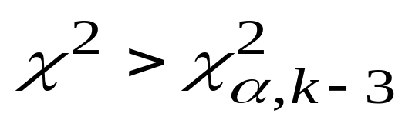
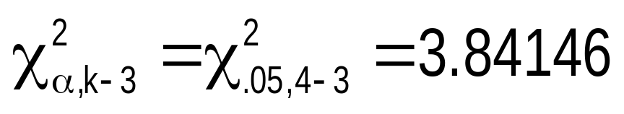
The test statistic
² =
(10 - 7.94)²
7.94
+
(13 - 17.07)²
17.07
+
(19 - 17.07)²
17.07
+
(8 - 7.94)²
7.94
= 1.72
The rejection region
Conclusion: There is insufficient evidence to conclude at 5% significance level that the data are not approx. normally distributed.

Slide 17
Models for two-way tables
The chi-square test is an overall technique for comparing any number of population proportions, testing for evidence of a relationship between two categorical variables. There are 2 types of tests:
  Test for independence: Take one SRS and classify the individuals in the sample according to two categorical variables (attribute or condition) → observational study, historical design.
  Compare several populations (tests for homogeneity): Randomly select several SRSs each from a different population (or from a population subjected to different treatments) → experimental study.
Both models use the X² test to test of the hypothesis of no relationship.

Slide 18
Testing for independence
We have now a single sample from a single population. For each individual in this SRS of size n we measure two categorical variables. The results are then summarized in a two-way table.
The null hypothesis is that the row and column variables are independent. The alternative hypothesis is that the row and column variables are dependent.

Slide 19
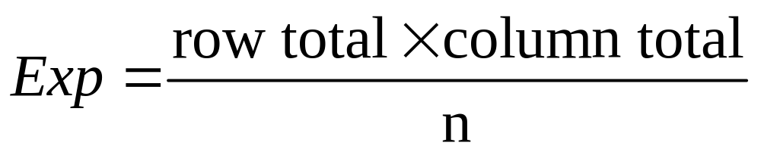
Chi-square tests for independence
Expected cell frequencies:
Where:
row total = sum of all frequencies in the row
column total = sum of all frequencies in the column
n = overall sample size
H₀: The two categorical variables are independent
(i.e., there is no relationship between them)
H₁: The two categorical variables are dependent
(i.e., there is a relationship between them)

Slide 20
Example 1: Parental smoking
Does parental smoking influence the incidence of smoking in children when they reach high school? Randomly chosen high school students were asked whether they smoked (columns) and whether their parents smoked (rows).
Are parent smoking status and student smoking status related?
H₀ : parent smoking status and student smoking status are independent
H_{A} : parent smoking status and student smoking status are not independent
 |  | Student
 |  | Smoke | No smoke | Total
 | Both smoke | 400 | 1380 | 1780
Parent | One smokes | 416 | 1823 | 2239
 | Neither smokes | 188 | 1168 | 1356
 | Total | 1004 | 4371 | 5375

Slide 21
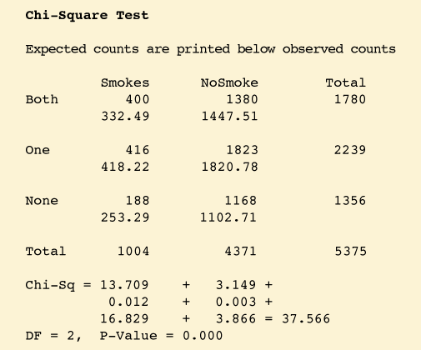
Example 1: Parental smoking (cont.)
Does parental smoking influence the incidence of smoking in children when they reach high school? Randomly chosen high school students were asked whether they smoked (columns) and whether their parents smoked (rows).
Examine the computer output for the chi-square test performed on these data. What does it tell you?
Hypotheses?
Are data ok for χ² test? (All expected counts 5 or more)
df = (rows-1)*(cols-1)=2*1=2
Interpretation? Since P-value is less than .05, reject H₀ and conclude that parent smoking status and student smoking status are related.

Slide 22
Example 2: meal plan selection
The meal plan selected by 200 students is shown below:
Class Standing | Number of meals per week |  |  | Total
 | 20/week | 10/week | none
Fresh. | 24 | 32 | 14 | 70
Soph. | 22 | 26 | 12 | 60
Junior | 10 | 14 | 6 | 30
Senior | 14 | 16 | 10 | 40
Total | 70 | 88 | 42 | 200

Slide 23
Example 2: meal plan selection (cont.)
The hypotheses to be tested are:
H₀: Meal plan and class standing are independent
(i.e., there is no relationship between them)
H₁: Meal plan and class standing are dependent
(i.e., there is a relationship between them)

Slide 24
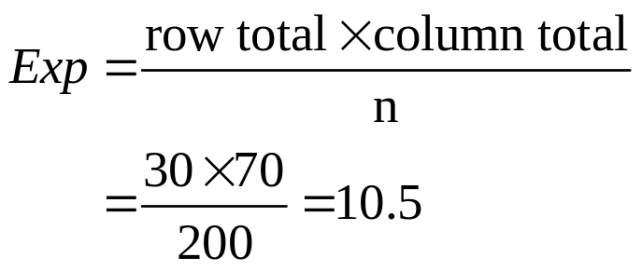
Example 2: meal plan selection (cont.)
Expected Cell Frequencies
Observed:
Class Standing | Number of meals per week |  |  | Total
 | 20/wk | 10/wk | none
Fresh. | 24 | 32 | 14 | 70
Soph. | 22 | 26 | 12 | 60
Junior | 10 | 14 | 6 | 30
Senior | 14 | 16 | 10 | 40
Total | 70 | 88 | 42 | 200
Expected cell frequencies if H₀ is true:
Class Standing | Number of meals per week |  |  | Total
 | 20/wk | 10/wk | none
Fresh. | 24.5 | 30.8 | 14.7 | 70
Soph. | 21.0 | 26.4 | 12.6 | 60
Junior | 10.5 | 13.2 | 6.3 | 30
Senior | 14.0 | 17.6 | 8.4 | 40
Total | 70 | 88 | 42 | 200
Example for one cell:

Slide 25
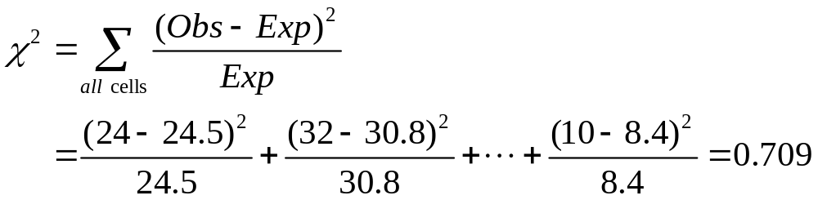
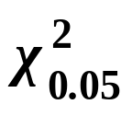
Example 2: meal plan selection (cont.) The Test Statistic
The test statistic value is:
= 12.592 from the chi-squared distribution with (4 – 1)(3 – 1) = 6 degrees of freedom

Slide 26
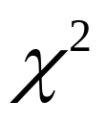

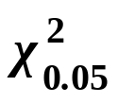
Example 2: meal plan selection (cont.)
Decision and Interpretation
Decision Rule:
If > 12.592, reject H₀, otherwise, do not reject H₀
0.05
Here,
= 0.709 < = 12.592,
so do not reject H₀
Conclusion: there is not sufficient evidence that meal plan and class standing are related.
0
χ²
Do not
reject H₀
Reject H₀
χ²_{0.05}=12.592

Slide 27
Models for two-way tables
The chi-square test is an overall technique for comparing any number of population proportions, testing for evidence of a relationship between two categorical variables. There are 2 types of tests:
Test for independence: Take one SRS and classify the individuals in the sample according to two categorical variables (attribute or condition) → observational study, historical design.
NEXT:
  Compare several populations (tests for homogeneity): Randomly select several SRSs each from a different population (or from a population subjected to different treatments) → experimental study.
Both models use the X² test to test of the hypothesis of no relationship.

Slide 28
Comparing several populations (tests for homogeneity)
Select independent SRSs from each of c populations, of sizes
n₁, n₂, . . . , n_{c}. Classify each individual in a sample according to a categorical response variable with r possible values. There are c different probability distributions, one for each population.
The null hypothesis is that the distributions of the response variable are the same in all c populations. The alternative hypothesis says that these c distributions are not all the same.

Slide 29
Chi-Square Test for Homogeneity
Appropriate when the following conditions are met:
Observed counts are from independently selected random samples or subjects in an experiment are randomly assigned to treatment groups.
The sample sizes are large. The sample size is large enough for the chi-square test for homogeneity if every expected count is at least 5.
If some expected counts are less than 5, rows or columns of the table may be combined to achieve a table with satisfactory expected counts.

Slide 30
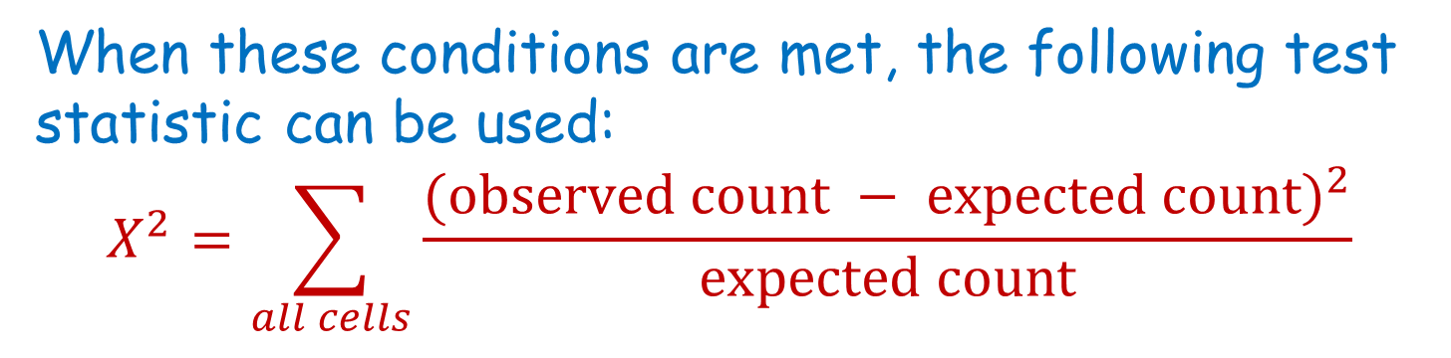
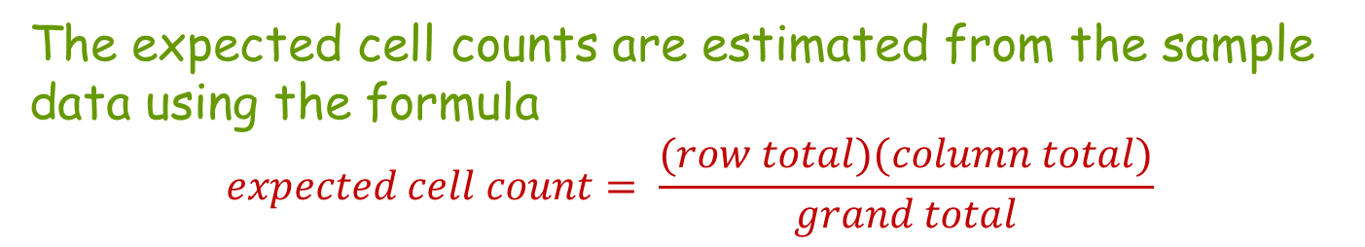
Chi-Square Test for Homogeneity
When the conditions above are met and the null hypothesis is true, the X ² statistic has a chi-square distribution with
df = (number of rows – 1)(number of columns – 1)

Slide 31
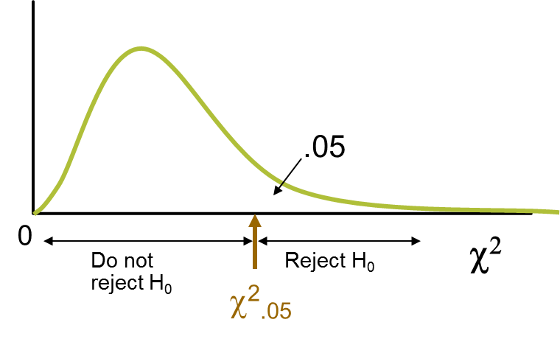

Chi-Square Test for Homogeneity
Hypothesis:
H₀: the population (or treatment) category proportions are the same for all the populations (or treatments)
H_{a}: the population (or treatment) category proportions are not all the same for all the populations (or treatments)
Associated P-value: The P-value associated with the computed test statistic value is the area to the right of X ² under the chi-square curve with
df = (no. of rows – 1)(no. of cols. – 1)

Slide 32

A study was conducted to determine if collegiate soccer players had in increased risk of concussions over other athletes or students. The two-way frequency table below displays the number of previous concussions for students in independently selected random samples of 91 soccer players, 96 non-soccer athletes, and 53 non-athletes.
 | Number of Concussions
 | 0 | 1 | 2 | 3 or more | Total
Soccer Players | 45 | 25 | 11 | 10 | 91
Non-Soccer Players | 68 | 15 | 8 | 5 | 96
Non-Athletes | 45 | 5 | 3 | 0 | 53
Total | 158 | 45 | 22 | 15 | 240
This is univariate categorical data - number of concussions - from 3 independent samples.

Slide 33
A study was conducted to determine if collegiate soccer players had in increased risk of concussions over other athletes or students. The two-way frequency table below displays the number of previous concussions for students in independently selected random samples of 91 soccer players, 96 non-soccer athletes, and 53 non-athletes.
Combine the category values “2 concussions” and “3 or more concussions” to create the category value “2 or more concussions)
Observed (Expected) | Number of Concussions
 | 0 | 1 | 2 | 3 or more | Total
Soccer Players | 45 (59.9) | 25 (17.1) | 11 (8.3) | 10 (5.7) | 91
Non-Soccer Players | 68 (63.2) | 15 (18.0) | 8 (8.8) | 5 (6.0) | 96
Non-Athletes | 45 (34.9) | 5 (10.0) | 3 (4.9) | 0 (3.3) | 53
Total | 158 | 45 | 22 | 15 | 240
(91*158)/240 = 59.9
The expected counts are shown in parentheses. Notice that two of the expected counts are less than 5.

Slide 34
Risky Soccer Continued . . .
 | Number of Concussions
 | 0 | 1 | 2 or more | Total
Soccer Players | 45 (59.9) | 25 (17.1) | 21 (14.0) | 91
Non-Soccer Players | 68 (63.2) | 15 (18.0) | 13 (14.8) | 96
Non-Athletes | 45 (34.9) | 5 (10.0) | 3 (8.2) | 53
Total | 158 | 45 | 37 | 240
Hypotheses:
H₀: Proportions in each head injury category are the same for all three groups.
H_{a}: The head injury category proportions are not all the same for all three groups.

Slide 35
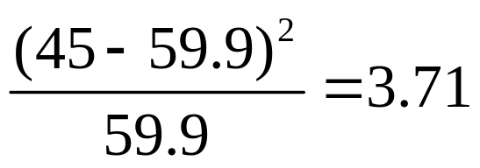

Risky Soccer Continued . . . test statistic
Observed (Expected) | Number of Concussions
 | 0 | 1 | 2 or more | Total
Soccer Players | 45 (59.9) | 25 (17.1) | 21 (14.0) | 91
Non-Soccer Players | 68 (63.2) | 15 (18.0) | 13 (14.8) | 96
Non-Athletes | 45 (34.9) | 5 (10.0) | 3 (8.2) | 53
Total | 158 | 45 | 37 | 240
 | Number of Concussions
Cell-by-cell chi-square test statistic values | 0 | 1 | 2 or more
Soccer Players | 3.71 | 3.65 | 3.50
Non-Soccer Players | 0.36 | 0.50 | 0.22
Non-Athletes | 2.92 | 2.50 | 3.30
df=(3-1)*(3-1)=4

Slide 36
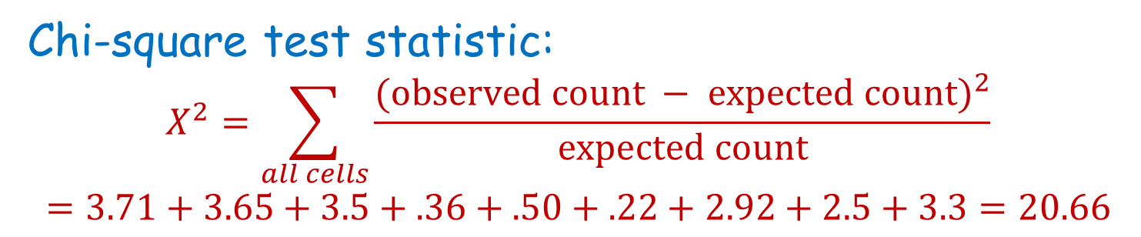
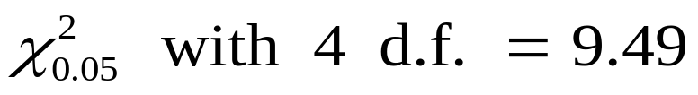
Risky Soccer Continued . . . P-value
P-value: P(χ²_{4df} > 20.66); P-value < 0.001
0.05
0
Do not
reject H₀
20.66
χ²
Reject H₀
χ²_{0.05}=9.49

Slide 37
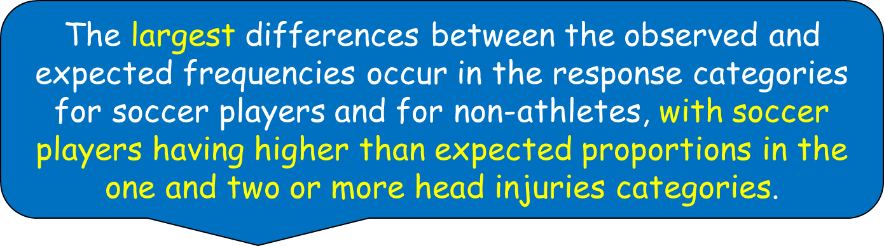
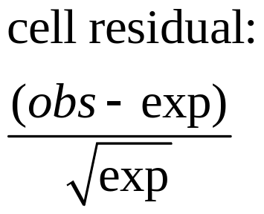
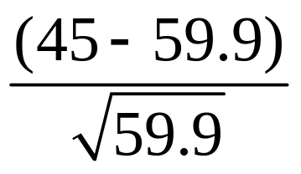
Risky Soccer Continued . . . Conclusion
P-value < 0.001. Because the P-value is less than 0.05, H₀ is rejected.
There is strong evidence that the proportions in the head injury categories are not the same for the three groups. How do they differ? Check cell residuals.
 | Number of Concussions
Residuals (obs-exp)/√(exp) | 0 | 1 | 2 or more
Soccer Players | -1.93 | 1.91 | 1.87
Non-Soccer Players | 0.60 | -0.71 | -0.47
Non-Athletes | 1.71 | -1.58 | -1.82

Slide 38
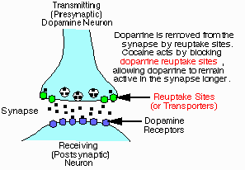
Example: Cocaine addiction (test for homogeneity)
Cocaine produces short-term feelings of physical and mental well being. To maintain the effect, the drug may have to be taken more frequently and at higher doses. After stopping use, users will feel tired, sleepy, and depressed.
The pleasurable high followed by unpleasant after-effects encourage repeated compulsive use, which can easily lead to dependency.
We compare treatment with an anti-depressant (desipramine), a standard treatment (lithium), and a placebo.
Population 1: Antidepressant treatment (desipramine)
Population 2: Standard treatment (lithium)
Population 3: Placebo (“sugar pill”)

Slide 39
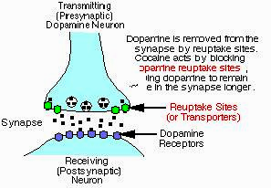
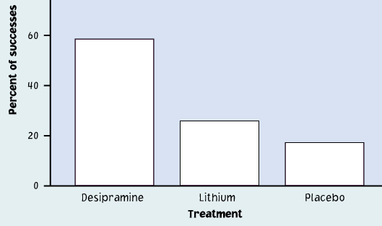
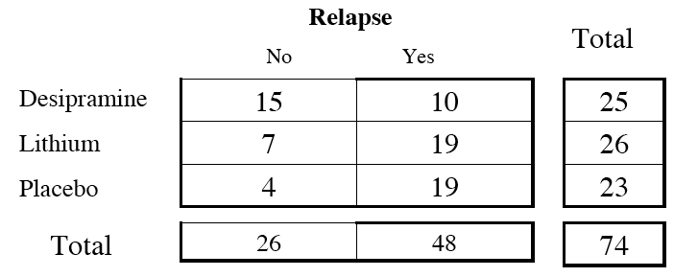
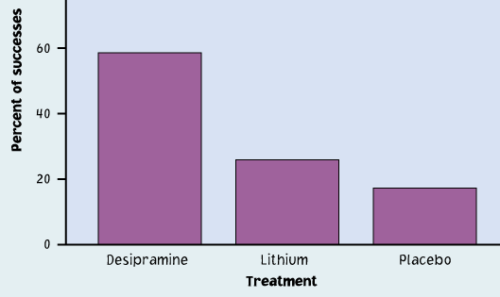
Cocaine addiction
H₀: The proportions of success (no relapse) are the same in all three populations.
Observed
Expected
Expected relapse counts
No Yes
35%
35%
35%
Desipramine
Lithium
Placebo
25*26/74 ≈ 8.78 25*0.35 | 16.22 25*0.65
9.14 26*0.35 | 16.86 25*0.65
8.08 23*0.35 | 14.92 25*0.65

Slide 40
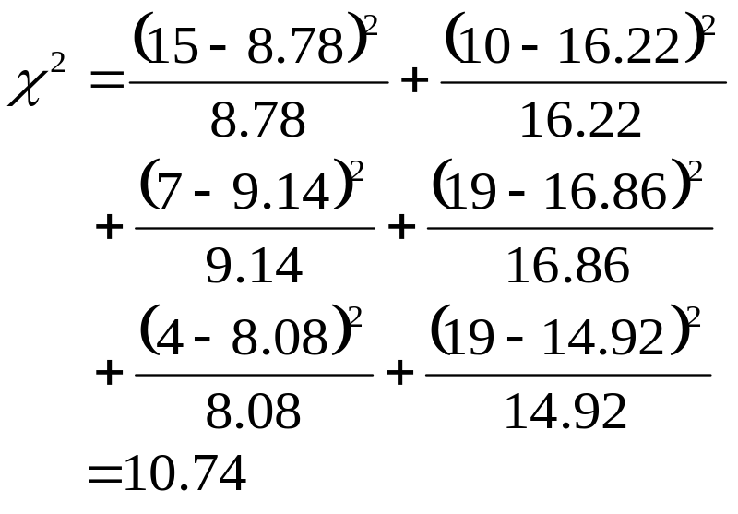
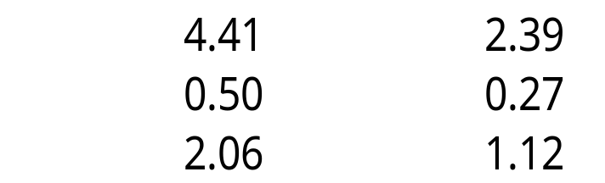
Cocaine addiction
No relapse Relapse
Table of counts:
“actual / expected,” with three rows and two columns:
df = (3−1)*(2−1) = 2
15 8.78 | 10 16.22
7 9.14 | 19 16.86
4 8.08 | 19 14.92
Desipramine
Lithium
Placebo
χ² components:

Slide 41

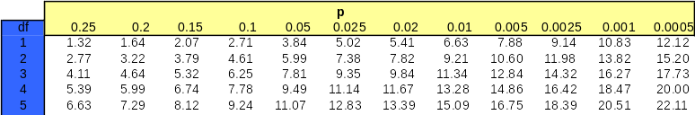
Cocaine addiction: Table χ
H₀: The proportions of success (no relapse) are the same in all three populations.
X² = 10.71 > 5.99; df = 2
➔ reject the H₀
➔The proportions of success are not the same in
all three populations (Desipramine, Lithium, Placebo).
Desipramine is a more successful treatment →→→
Observed

Slide 42





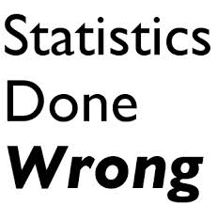
Avoid These Common Mistakes

Slide 43

Avoid These Common Mistakes
Don’t confuse tests for homogeneity with tests for independence. The hypotheses and conclusions are different for the two types of test.
Tests for homogeneity are used when the individuals in each of two or more independent samples are classified according to a single categorical variable.
Tests for independence are used when individuals in a single sample are classified according to two categorical variables.

Slide 44

Avoid These Common Mistakes
Remember that a hypothesis test can never show strong support for the null hypothesis.
For example, if you do not reject the null hypothesis in a chi-square test for independence, you cannot conclude that there is convincing evidence that the variables are independent. You can only say that you were not convinced that there is an association between the variables.

Slide 45

Avoid These Common Mistakes
Be sure that the conditions for the chi-square test are met.
P-values based on the chi-square distribution are only approximate, and if the large sample condition is not met, the actual P-value may be quite different from the approximate one based on the chi-square distribution.
Also, for the chi-square test of homogeneity, the assumption of independent samples is particularly important.

Slide 46

Avoid These Common Mistakes
Don’t jump to conclusions about causation. Just as a strong correlation between two numerical variables does not mean that there is a cause-and-effect relationship between them, an association between two categorical variables does not imply a causal relationship.

